Slide 1
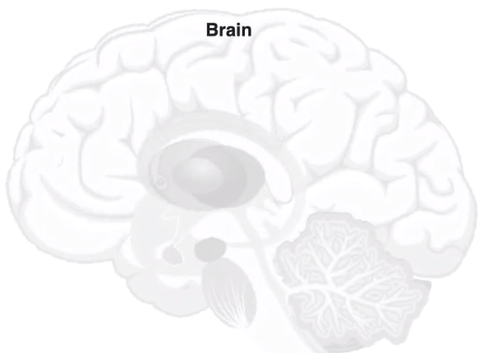

Functional Connectivity Correlates to Individual Difference in Human Brains during Working Memory Task and Resting State
Hao-Lun Hsu
2021 IEEE EMB
2021 IEEE EMBS ISC Presentation
2021 IEEE EMB

Slide 2
Working Memory Model
Working Memory: the processes that are used to temporarily store, organize, and manipulate information
Central Executive
Phonological Loop
Episodic Buffer
Visuo-Spatial
Scratchpad
Notes:
supervising the integration of information

Slide 3
Background & Current Studies
How resting-state functional connectivity was impaired in individuals with abnormal working memory
Notes:
To understand how multiple brain regions work together to support working memory, researchers usually utilized a functional connectivity analysis.
Current functional connectivity studies of working memory mainly focus on two direct -- how resting-state functional connectivity was impaired in individuals with abnormal working memory and how different types of information was processed by divergent brain networks within the working memory scope.

Slide 4
Background & Current Studies
How resting-state functional connectivity was impaired in individuals with abnormal working memory
How different types of information was processed by divergent brain networks within the working memory scope
Notes:
To understand how multiple brain regions work together to support working memory, researchers usually utilized a functional connectivity analysis.
Current functional connectivity studies of working memory mainly focus on two direct -- how resting-state functional connectivity was impaired in individuals with abnormal working memory and how different types of information was processed by divergent brain networks within the working memory scope.

Slide 5
Motivation
A lack of studies asked whether the working memory network dynamics relate to normal individual performance differences
Notes:
A lack of studies asked whether the working memory network dynamics relate to normal individual performance differences.
Also, while resting-state functional connectivity studies were prevalent in network analyses on the brain, we wondered how the brain network changes from rest to task state in relation to working memory capacity.

Slide 6
Motivation
A lack of studies asked whether the working memory network dynamics relate to normal individual performance differences
How the brain network changes between task and rest states in relation to working memory capacity.
Notes:
A lack of studies asked whether the working memory network dynamics relate to normal individual performance differences.
Also, while resting-state functional connectivity studies were prevalent in network analyses on the brain, we wondered how the brain network changes from rest to task state in relation to working memory capacity.
can we construct the whole brain network mapping for human working memory and identify the hub regions which provide the most supports for working memory function. 2) can we identify network differences that contribute to individual differences in working memory performance? 3) how does the restingstate brain network differ in its topology from the task state brain network for working memory function
This is a reasonable question to ask for working memory because by its definition, working memory is a consistent state of the brain while awake. We wondered how the brain would change by adding more working memory load

Slide 7
Hypothesis
Stronger connection between prefrontal cortex, basal ganglia (caudate) and hippocampus
Notes:
We hypothesize that we will find stronger connection between these areas in subjects with better performance in working memory task
We are also supposed to find a weaker connective network generally in resting state compared with in task state, but we think there should be different in good performers and bad performers in resting state.
The literature on brain and working memory has already identified brain areas such as the prefrontal cortex and basal ganglia including the thalamus and caudate that are involved in representing and holding information during a working memory task.

Slide 8
Hypothesis
Stronger connection between prefrontal cortex, basal ganglia (caudate) and hippocampus
Weaker connective network in resting state compared with in task state
Notes:
We hypothesize that we will find stronger connection between these areas in subjects with better performance in working memory task
We are also supposed to find a weaker connective network generally in resting state compared with in task state, but we think there should be different in good performers and bad performers in resting state.
prefrontal cortex and basal ganglia including the thalamus and caudate that are involved in representing and holding information during a working memory task.
thalamus, hippocampus, and prefrontal cortex

Slide 9
Working Memory Data
Each trial presents a single object centered on the screen
Participants press one of the two buttons to indicate if the object is target
Target
Current trial
2-back blocks
Body part
Body part
Place
Face
Tool
Face
0-back blocks
Tool
Body part
Tool
Place
Tool
Face
Target
Current trial
Data is from Human Connectome Project
Notes:
We hypothesize that we will find stronger connection between these areas in subjects with better performance in working memory task
We are also supposed to find a weaker connective network generally in resting state compared with in task state, but we think there should be different in good performers and bad performers in resting state.

Slide 10
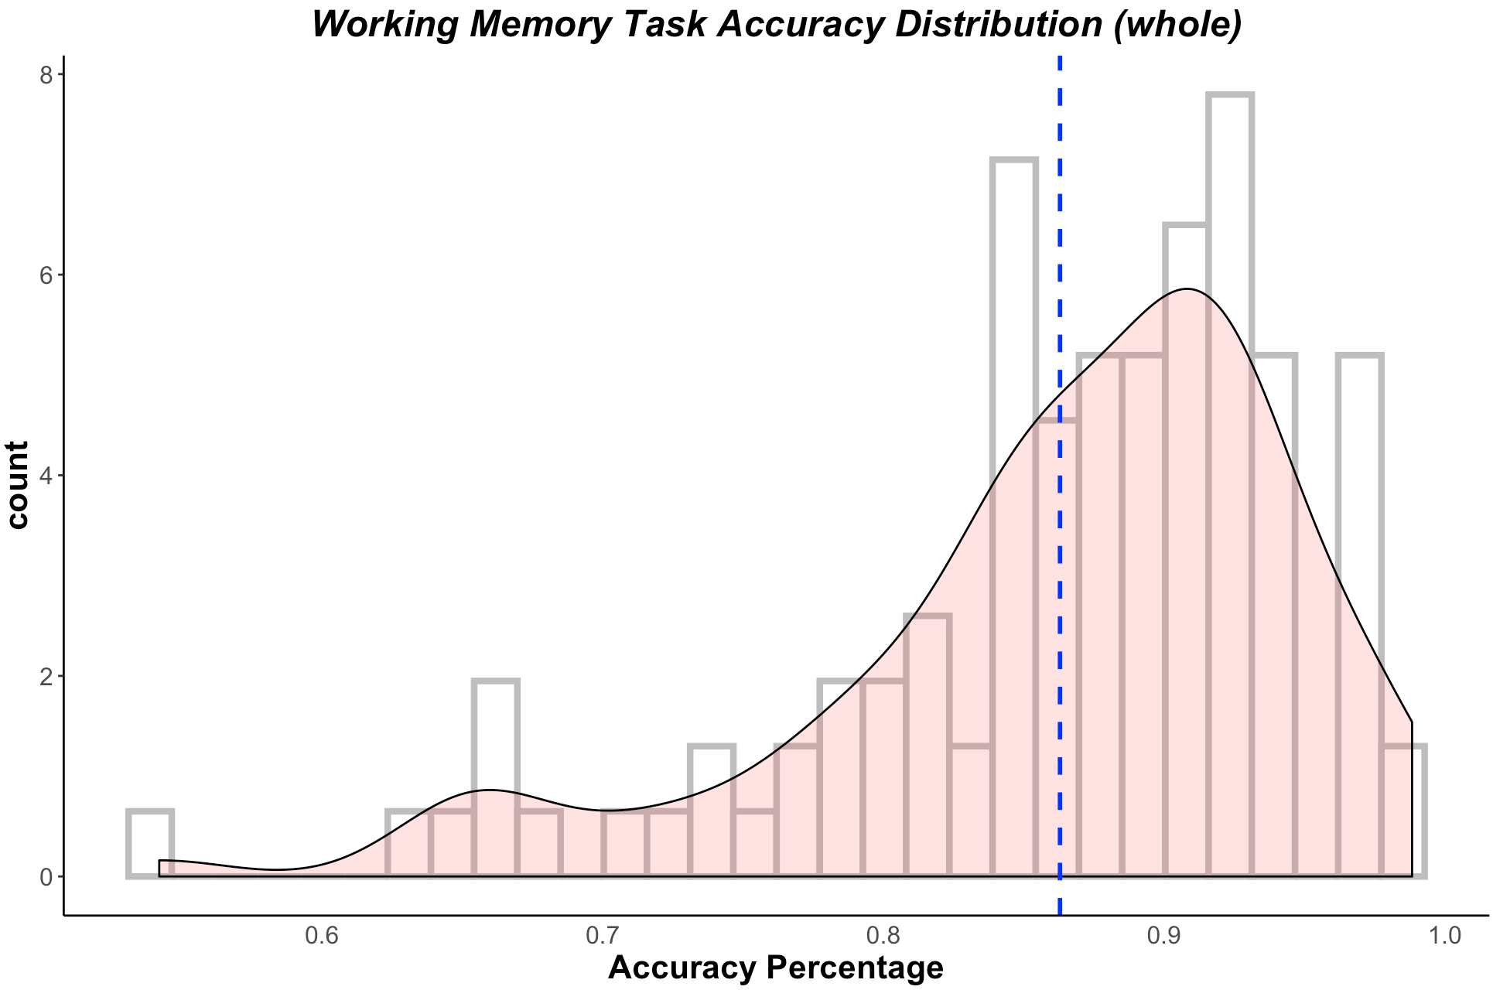
Working Memory Task Accuracy Distribution
Split the subjects into two groups using the mean as mid-line
40 good performers, 60 poor performers
Notes:
In order to analyze group-level functional connectivity, we firstly divided the subjects into groups based on the behavioral results. The figure on the slide shows the working memory task accuracy distribution of the whole subjects. We divided the subjects into 2 groups -- poor performers and good performers using mean as the midline. This results will be a comparison in following analyses

Slide 11
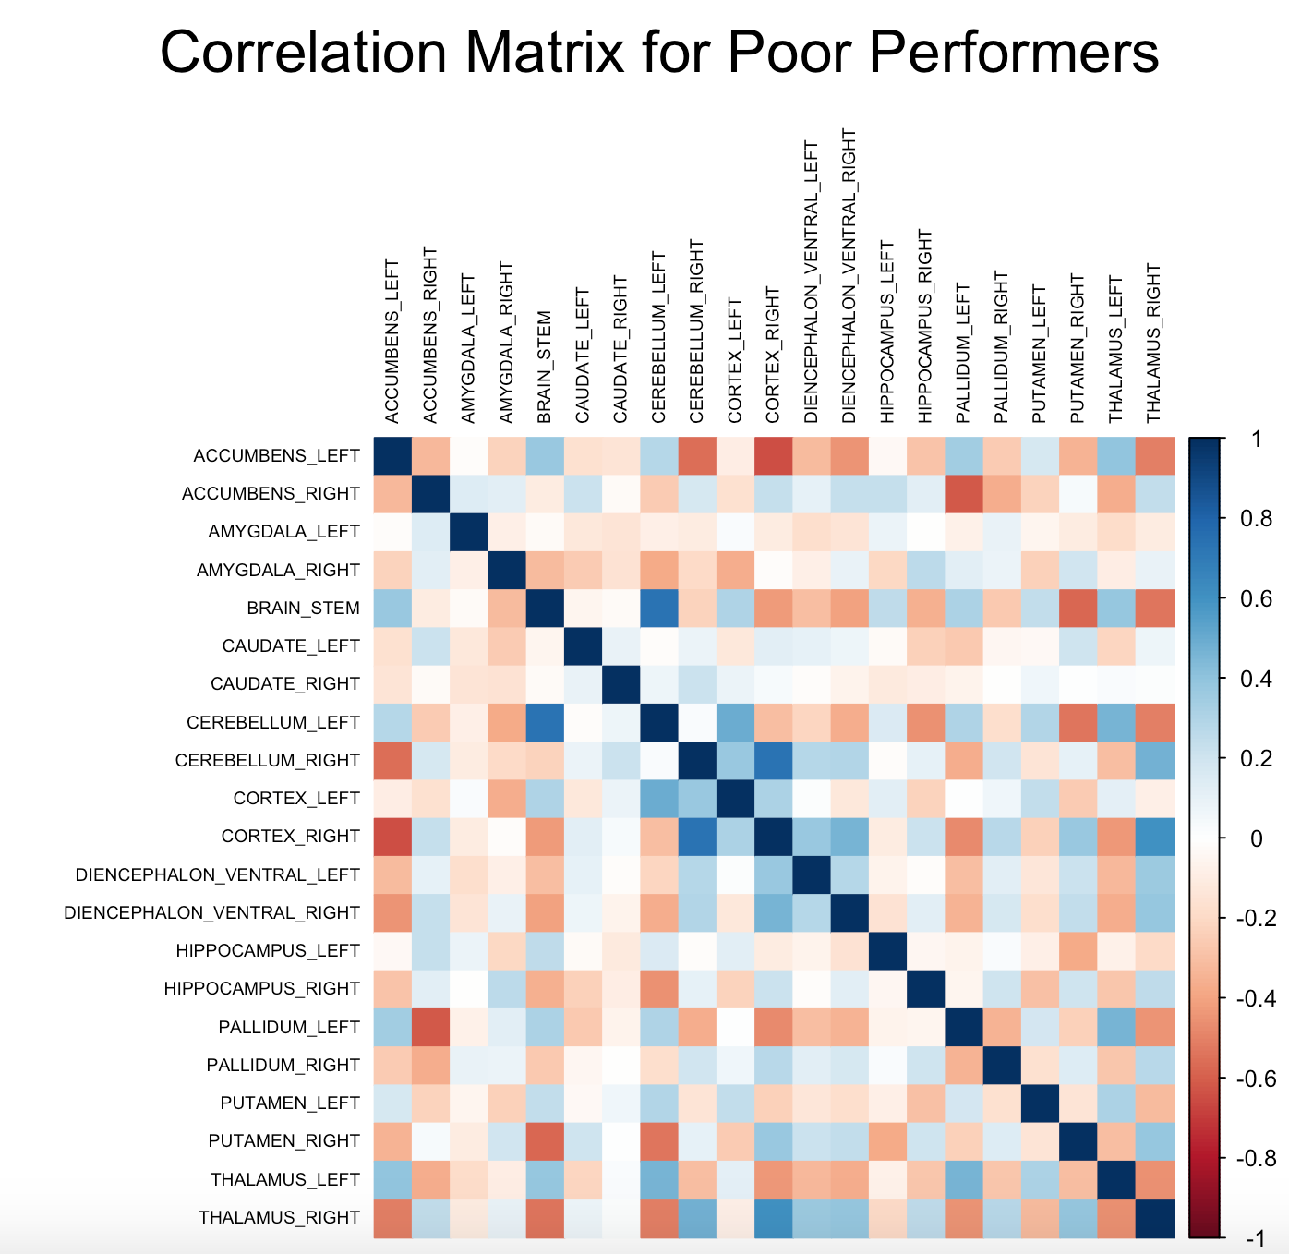
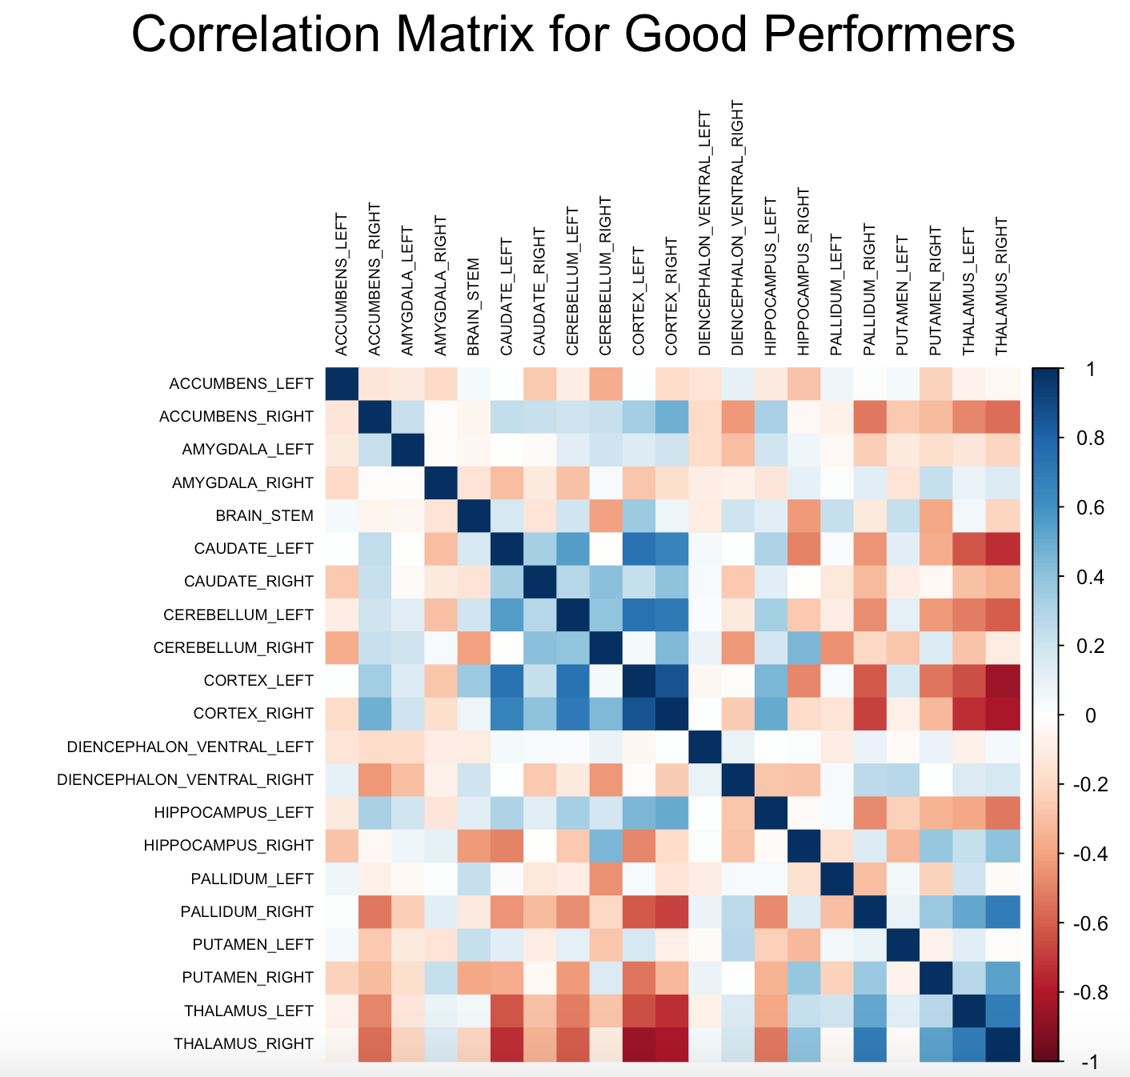
Correlation Matrix in Task State
Higher level of correlation distance in good performers compared with in poor ones
High correlation between cortex and hippocampus as well as between cortex and caudate
Notes:
Then we made the correlation in two groups corresponding to their subjects based on behavioral results.
Figures showed the correlation matrix for 21 regions’ averaged activation across time-series within each group in task state. We found a higher level of correlation distance in good performers compared with poor performers. To be more specific, we found high correlation between cortex and thalamus as well as between cortex and caudate.
Column x raw: time series (point) x voxel, number of voxels in each brain region
In each subject, Average the values within each region, normalize the time series in region via z-score, and then do the correlation ,
Take average on the correlation matrix across group → clustering
Correlation in brain: 0.5 is good enough

Slide 12
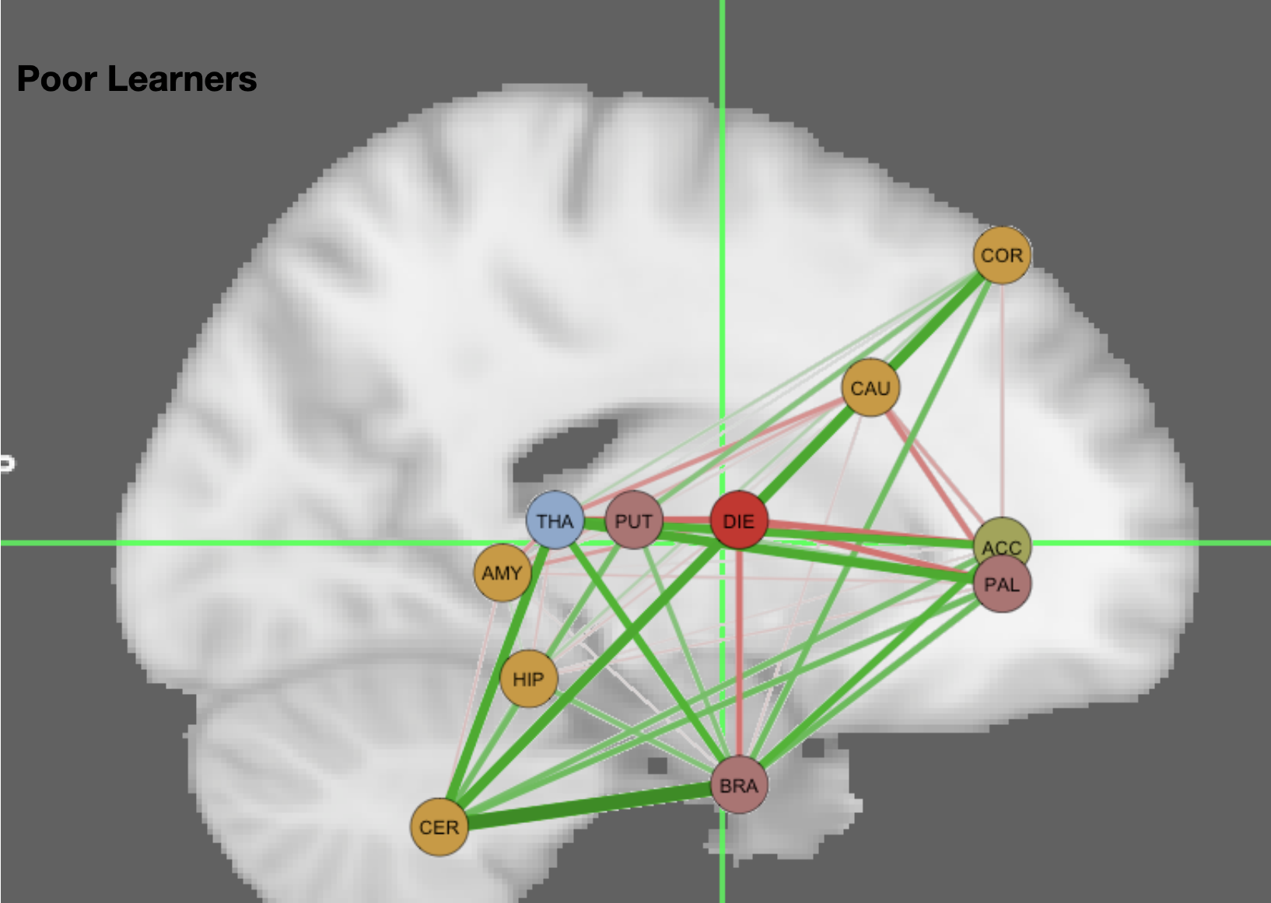
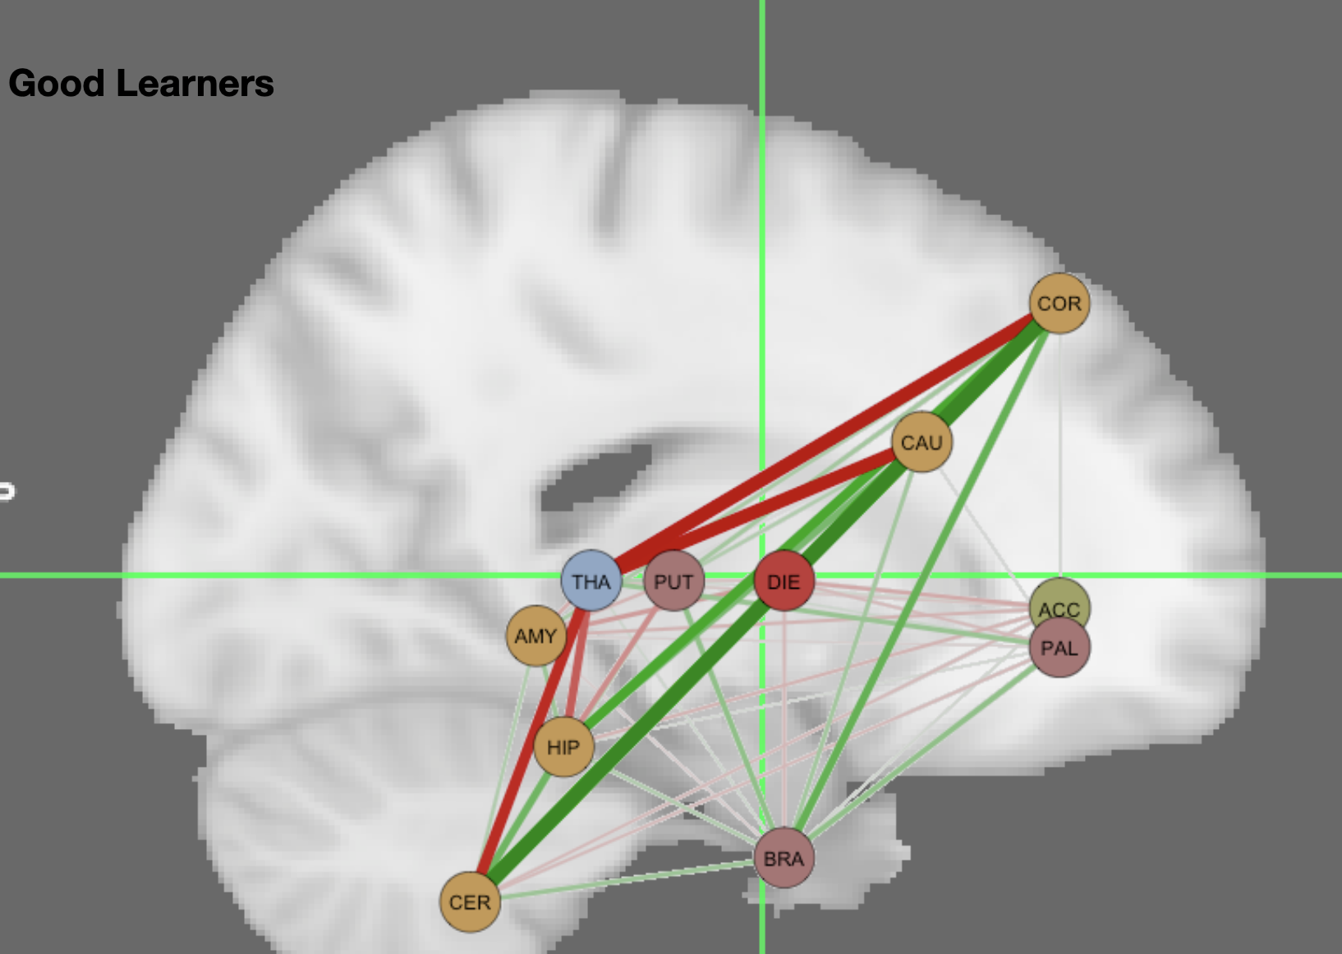
Hierarchical Clustering in Task State
Node: parcellation of the left hemisphere
→ same cluster with same color
Edge: correlation distance (negative: red, positive: green)
→ thickness/ translucency represents the strength of connection
Notes:
After we ran hierarchical clustering, we found the optimized number of clusters to be 5 in both poor learners and good learners. We visualized this result in Fig.3, which represents the left hemisphere brain network during working memory task state. Corresponding to the correlation matrix results, we found stronger connections between nodes and a more activated network in good performers versus bad performers
each node represents one parcellation of the left hemisphere. Nodes in the same color belong to the same cluster according to hierarchical clustering results. The edge represents correlation distance and negative correlations are shown in red and positive correlations are shown in green. The Thickness and translucency represent the strength of the connection (absolute value of the correlation distance). Left: poor performers. Right: good performers.

Slide 13
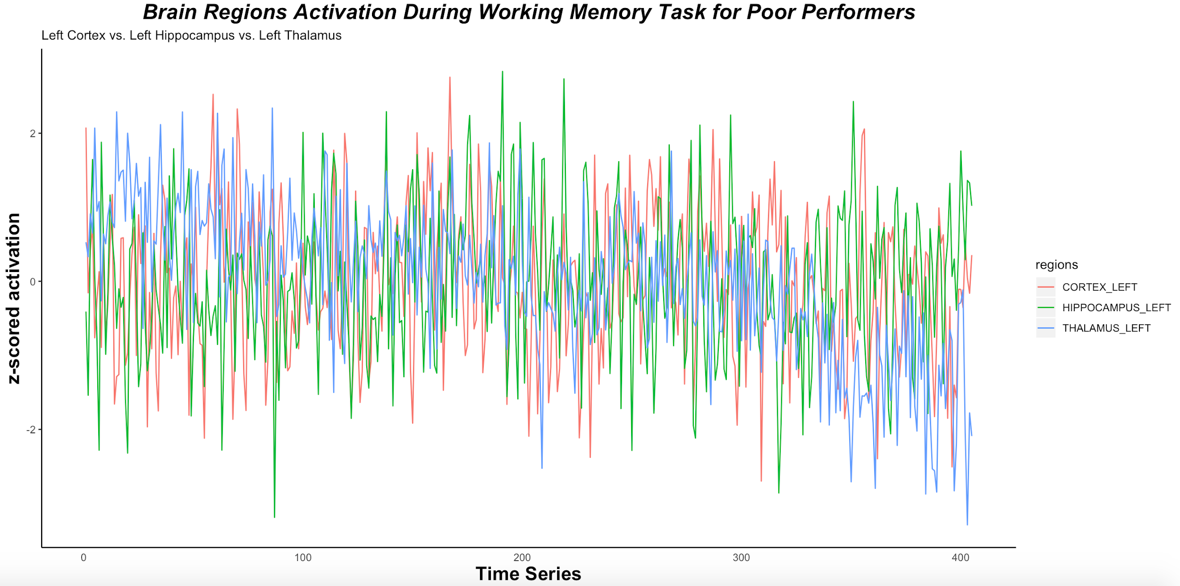
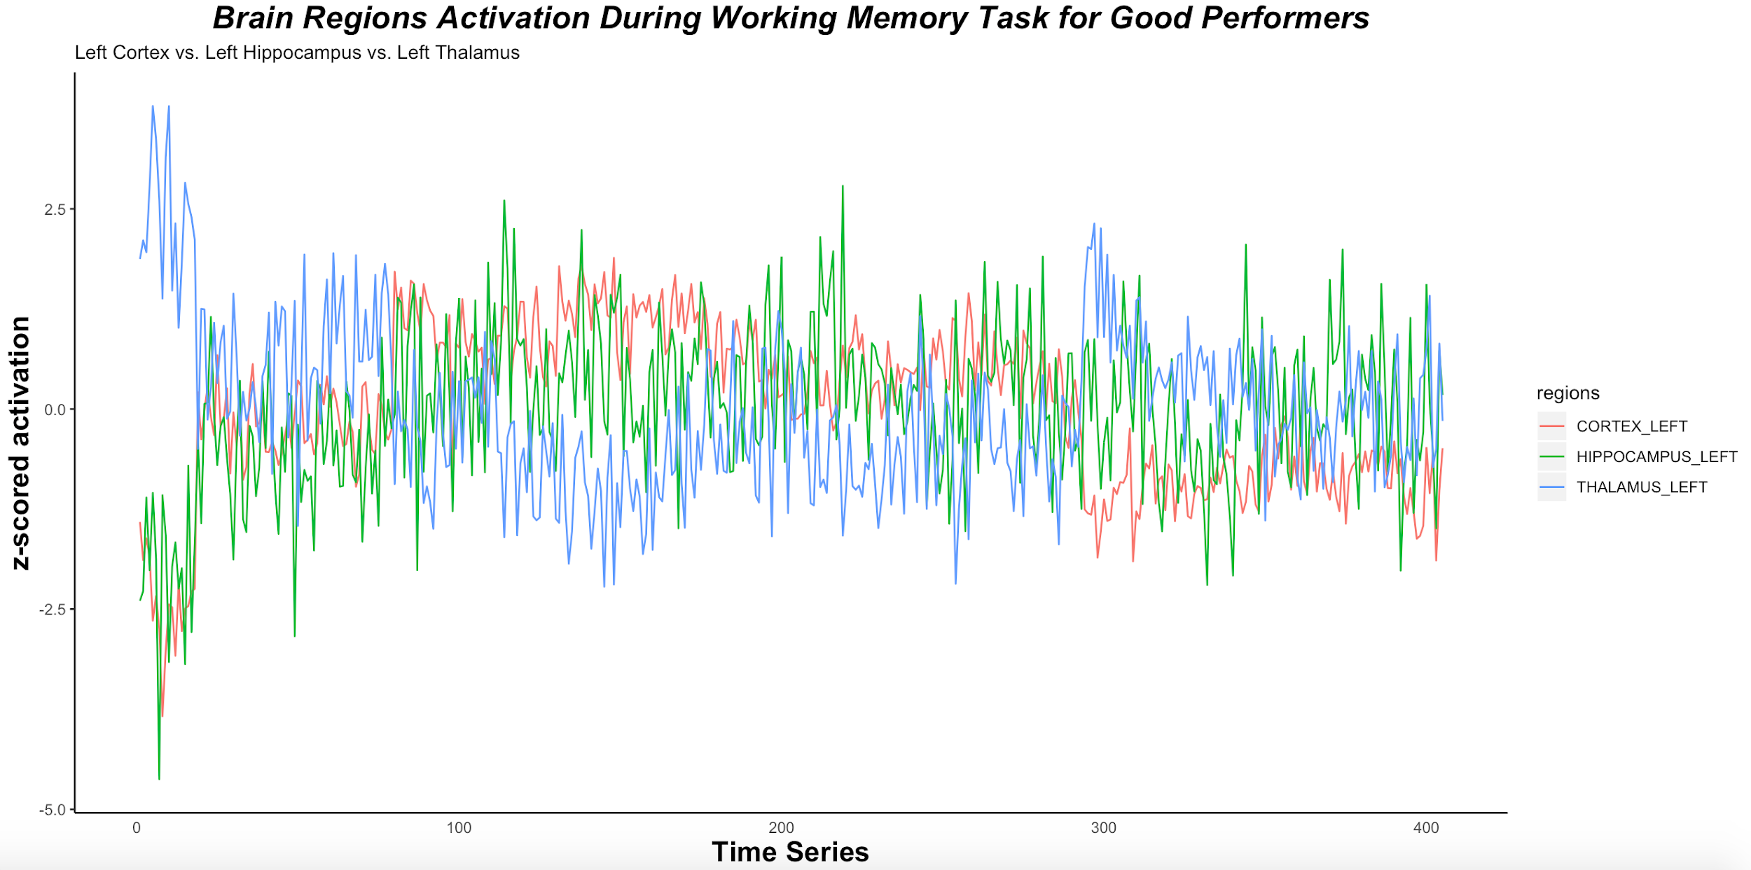
Brain Acitvation during Task State
Poor performers: weak correspondence among these three areas
Good performers: the thalamus showed opposite activity direction from cortex while hippocampus showed similar trends to cortex
Notes:
Because we specifically targeted functional connectivity among the thalamus-hippocampus-prefrontal cortex circuits, we also plotted out the brain activity across time series during the working memory task for these 3 areas in Fig.4. It showed that in good learners, the thalamus showed opposite activity direction from cortex while hippocampus showed similar trends to cortex. In the poor performers group, there’s weak correspondence among these three areas.

Slide 14
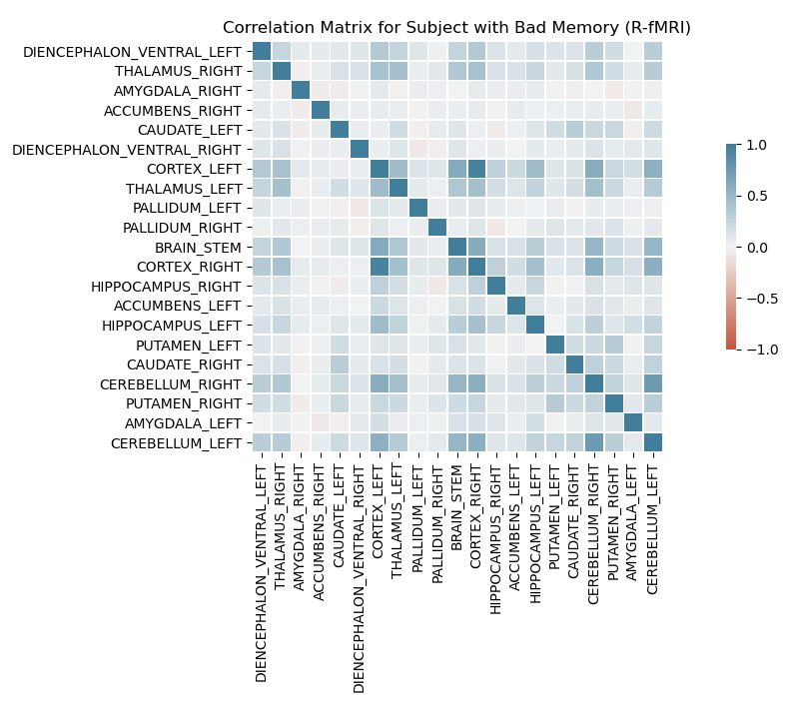
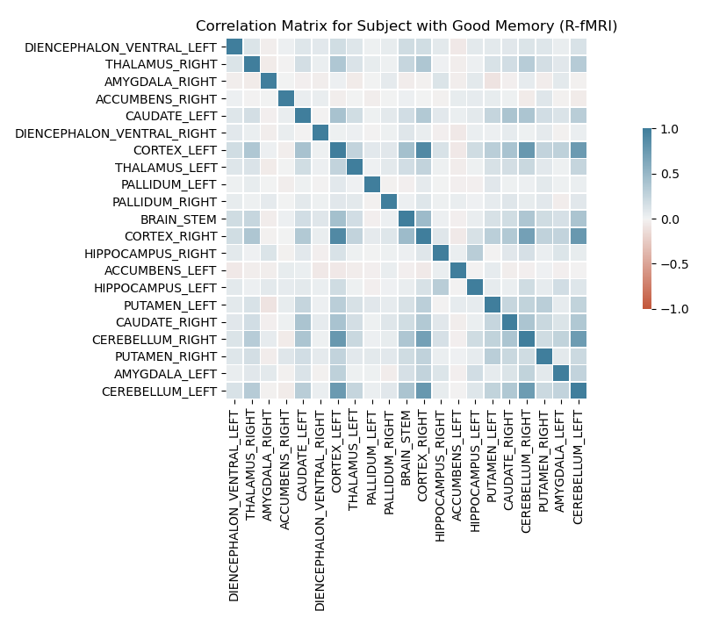
Correlation Matrix in Resting State
Tiny difference in the correlation between two groups
Correlation Matrix for Poor Performers
Correlation Matrix for Good Performers
Notes:
Fig. 2 showed the correlation matrix for 21 regions’ averaged activation across time-series within each group. We found a higher level of correlation distance in good performers than poor performers (deeper color shown in the right figure). Specifically, we found high correlation between cortex and thalamus as well as between cortex and caudate. After we ran hierarchical clustering, we found the optimized number of clusters to be 5 in both poor learners and good learners. we also plotted out the brain activity across time series during the working memory task for these 3 areas in Fig.4. It showed that in good learners, the thalamus showed opposite activity direction from cortex while hippocampus showed similar trends to cortex. In the poor performers group, there’s weak correspondence among these three areas.

Slide 15
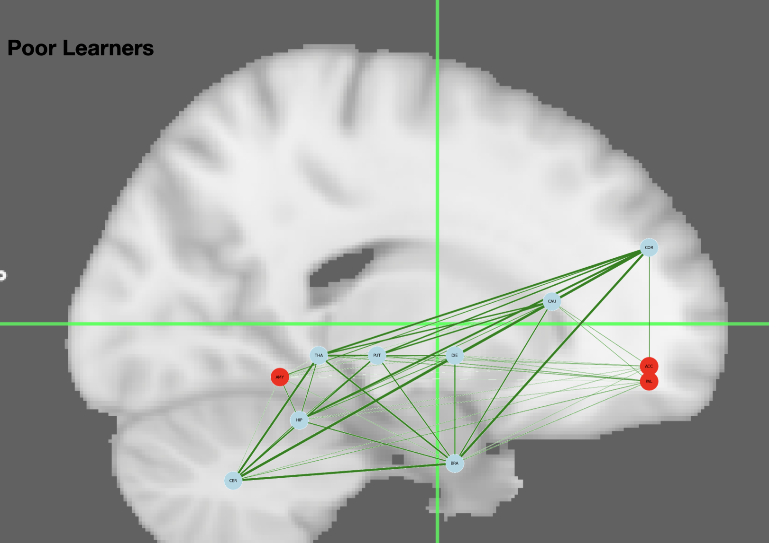
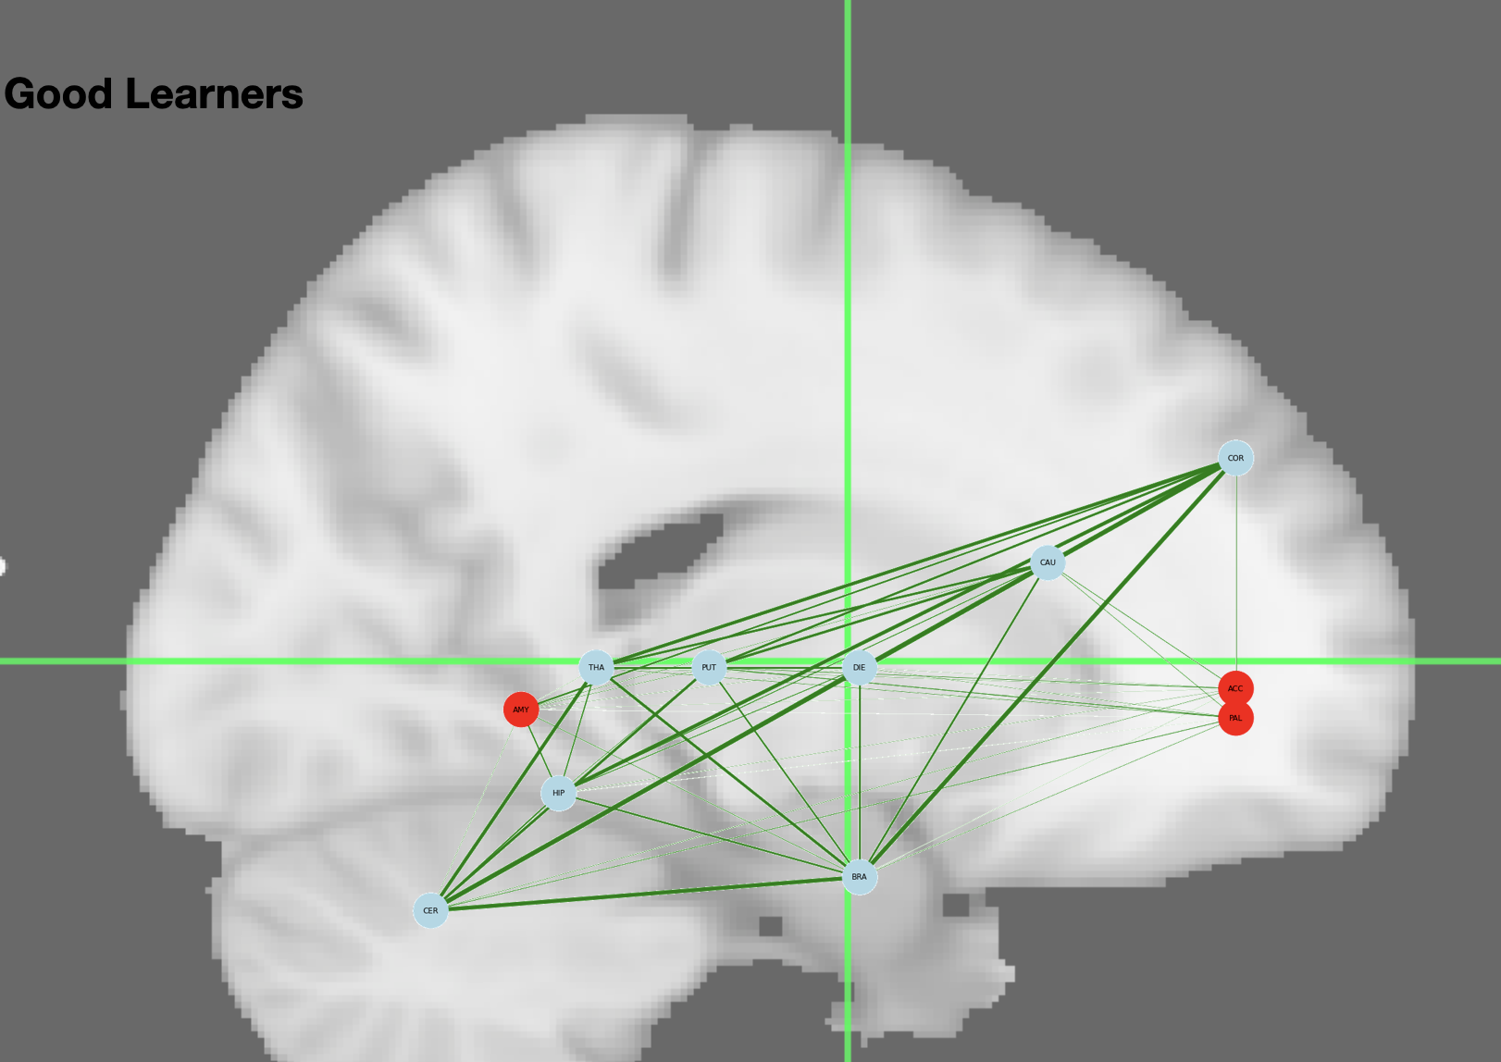
Hierarchical Clustering in Resting State
Node: parcellation of the left hemisphere
→ hard for clustering
Edge: correlation distance
→ thickness/ translucency represents the strength of connection

Slide 16
Conclusion
Strong connection between cortex, and caudate in good performers via fMRI in task state
Notes:
This group comparison provided evidence for a direct connection between working memory capacities and the communications between these areas, indicating that the neural foundation for working memory is not supported by each brain part independently but an interconnected network
Considering these areas were shown to be essential for emotion or motor tasks, it is reasonable to observe a ‘sleep’ mode for them during rest.

Slide 17
Conclusion
Strong connection between cortex, and caudate in good performers via fMRI in task state
Working memory is supported by an interconnected network
Notes:
This group comparison provided evidence for a direct connection between working memory capacities and the communications between these areas, indicating that the neural foundation for working memory is not supported by each brain part independently but an interconnected network
Considering these areas were shown to be essential for emotion or motor tasks, it is reasonable to observe a ‘sleep’ mode for them during rest.

Slide 18
Conclusion
Strong connection between cortex, and caudate in good performers via fMRI in task state
Working memory is supported by an interconnected network
Difficult to tell the difference between two groups via resting fMRI
Notes:
This group comparison provided evidence for a direct connection between working memory capacities and the communications between these areas, indicating that the neural foundation for working memory is not supported by each brain part independently but an interconnected network
Considering these areas were shown to be essential for emotion or motor tasks, it is reasonable to observe a ‘sleep’ mode for them during rest.

Slide 19
Conclusion
Strong connection between cortex, and caudate in good performers via fMRI in task state
Working memory is supported by an interconnected network
Difficult to tell the difference between two groups via resting fMRI
Amygdala, caudate and putamen were less activated during rest
→ related to emotion or motor tasks → sleep mode
Notes:
This group comparison provided evidence for a direct connection between working memory capacities and the communications between these areas, indicating that the neural foundation for working memory is not supported by each brain part independently but an interconnected network
Considering these areas were shown to be essential for emotion or motor tasks, it is reasonable to observe a ‘sleep’ mode for them during rest.

Slide 20
Conclusion
Strong connection between cortex, and caudate in good performers via fMRI in task state
Working memory is supported by an interconnected network
Difficult to tell the difference between two groups via resting fMRI
Amygdala, caudate and putamen were less activated during rest
→ related to emotion or motor tasks → sleep mode
Brain network becomes more activate from resting to task state in good performers
Notes:
This group comparison provided evidence for a direct connection between working memory capacities and the communications between these areas, indicating that the neural foundation for working memory is not supported by each brain part independently but an interconnected network
Considering these areas were shown to be essential for emotion or motor tasks, it is reasonable to observe a ‘sleep’ mode for them during rest.

